Slide 1
K-means
Luis Felipe Romero
Rafael Asenjo
Notes:
Storytelling, metáforas visuales y visualización de resultados

Slide 2
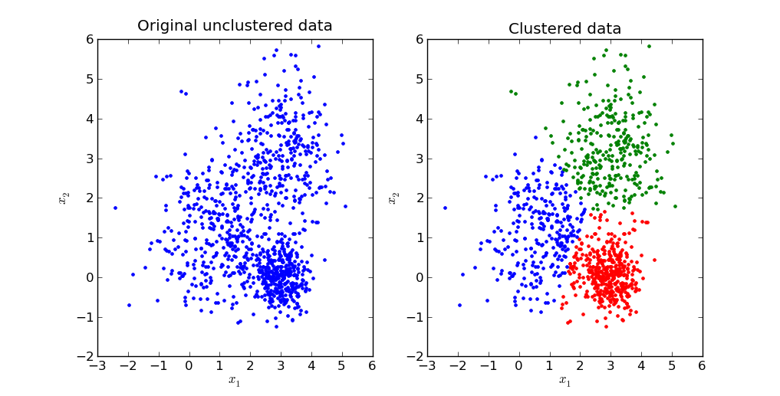
Clustering
A type of Unsupervised learning
Goal: to find groups(clusters) in the given data
K-means:
simple algorithm which clusters the data into K number of clusters

Slide 3
k-means
Algorithm:
Assume we have inputs x₁, x₂, x₃, ... x_{n}, and a value of K
Step 1 – Pick K random points as cluster centers called centroids.
Step 2 - Assign each x_{i​} to nearest cluster by calculating its distance to each centroid.
Step 3 - Find new cluster center by taking the average of the assigned points.
Step 4 - Repeat Step 2 and 3 until none of the cluster assignments change.

Slide 4
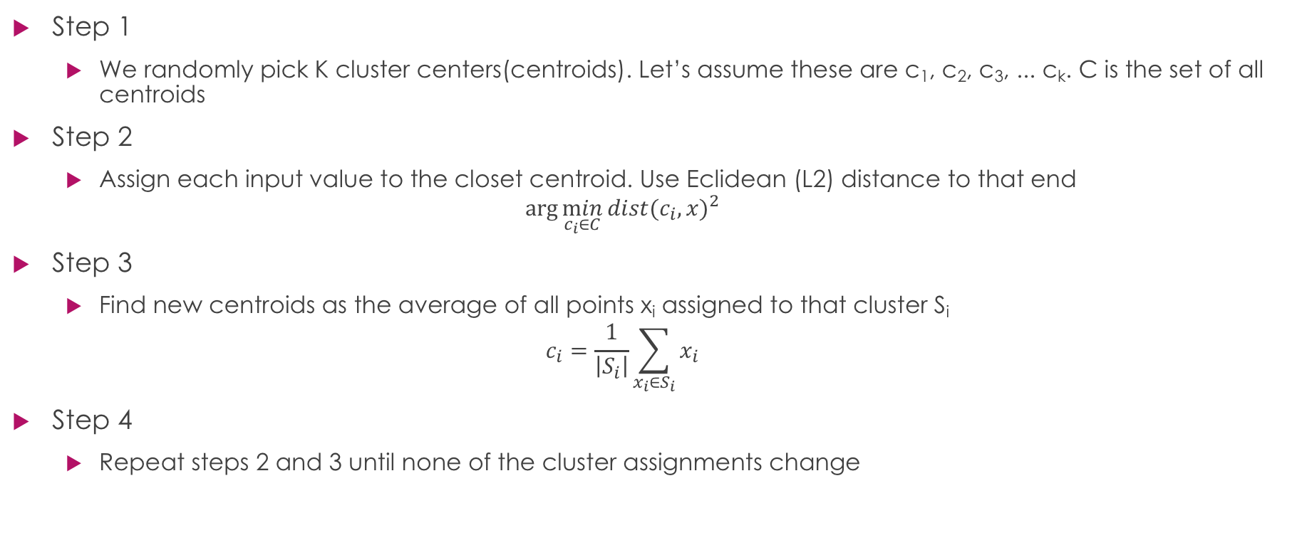
K-means details
Step 1
We randomly pick K cluster centers(centroids). Let’s assume these are c₁, c₂, c₃, ... c_{k}. C is the set of all centroids
Step 2
Assign each input value to the closet centroid. Use Eclidean (L2) distance to that end
$$\arg{\min_{c_{i}∈C}{{dist(c_{i},x)}^{2}}}$$
Step 3
Find new centroids as the average of all points x_{i} assigned to that cluster S_{i}
$$c_{i}=\frac{1}{\left|S_{i}\right|}\sum_{x_{i}∈S_{i}}{x_{i}}$$
Step 4
Repeat steps 2 and 3 until none of the cluster assignments change

